Slide 1


Sixth-fourth
Jacob T. Linao Cohort 23052022
BANK

Slide 2


AGENDA
INTRODUCTION
PRIMARY GOALS
Areas of growth
TIMELINE
SUMMARY
Demo

Slide 3




INTRO
At Sixth-Fourth Bank, we empower the people and business organizations to foster collaborative thinking to further drive financial innovation. By closing the loop and leveraging the latest industry technologies, we help businesses grow organically and foster a consumer-first mindset.

Slide 4
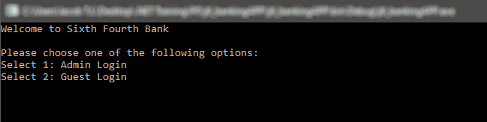
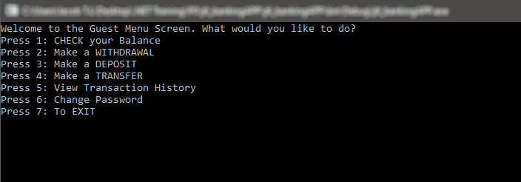
PRIMARY GOALS
Feature - Rich expansion
Secure banking
Secure investing
Build personalized budgets

Slide 5
BUSINESS OPPORTUNITIES ARE LIKE BUSES. THERE'S ALWAYS ANOTHER ONE COMING.
“
”
Richard Branson

Slide 6
PLAN FOR LAUNCH
DEPLOY financial conveniency at the tip of your fingers
PLANNING
REFRESHED sign-on experience
MARKETING
MOVE MONEY with competitive international rates
DESIGN
INSIGHT on spending trends and personalized budgets
FOSTER business & consumer-centered community
LAUNCH
STRATEGY

Slide 7
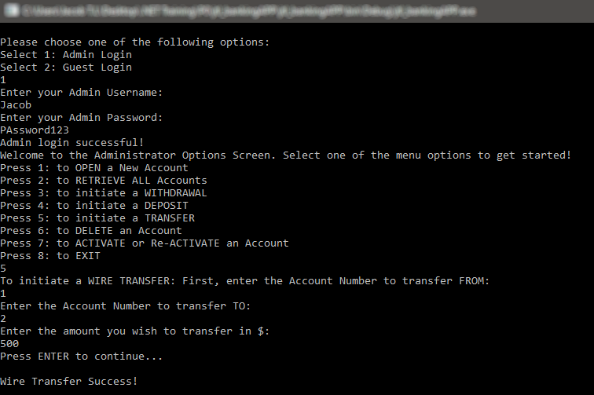
TIMELINE
JUL 2022 | REVAMPED Sign-On User Experience
AUG 2022 | MOVE MONEY With Competitive Rates
SEP 2022 | INSIGHT Making Spending Habits Work
OCT 2022 | FOSTER A Healthy Community For Businesses & Clients
NOV 2022 | DEPLOY Enhanced Financial Conveniency On Demand

Slide 8


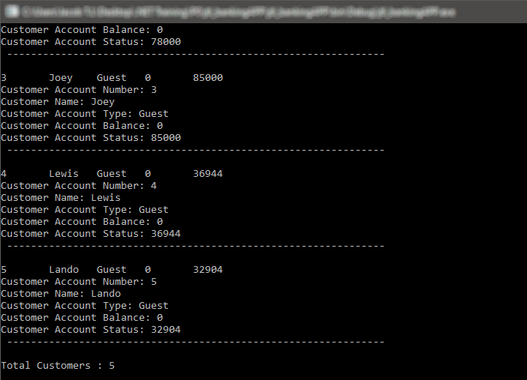


AREAS OF FOCUS
STUDY MARKET SCENARIOS
Develop winning strategies to keep ahead of the competition​
Capitalize on low-hanging fruit to identify a ballpark value​
Visualize customer directed services
CLOUD-BASED OPPORTUNITIES
Creative approaches to corporate strategy​
Establish a management framework from the inside

Slide 9



HOW WE GET THERE
ROI
NICHE MARKETS
SUPPLY CHAINS
Envision multimedia-based expertise and cross-media growth strategies
Engage worldwide methodologies with web-enabled technologies
Pursue scalable client services
Engage top-line web services with cutting-edge deliverables
Cultivate one-to-one customer service with robust ideas
Maximize client conveniency for real-time schemas

Slide 10

SUMMARY
At Sixth-Fourth Bank, we believe in giving 110%. By using our next-generation data architecture, we help organizations virtually manage agile workflows. We thrive because of our market knowledge and great team behind our product.

Slide 11
THANK YOU! Now, to the demo…
Jacob T. Linao
jacob638@revature.net
github.com/jacobtlin/My-Repository.git

